Slide 1
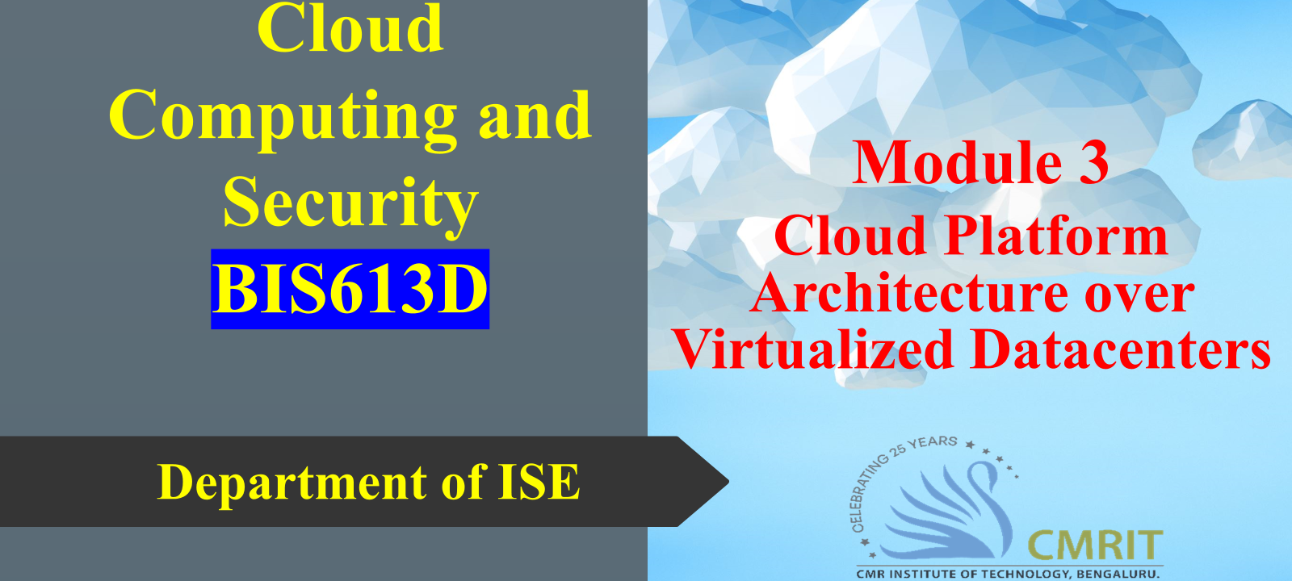

Slide 2
CLOUD SECURITY
11.1 SECURITY, THE TOP CONCERN FOR CLOUD USERS
11.2 CLOUD SECURITY RISKS
11.3 PRIVACY AND PRIVACY IMPACT ASSESSMENT
11.5 CLOUD DATA ENCRYPTION
11.6 SECURITY OF DATABASE SERVICES
11.7 OPERATING SYSTEM SECURITY
11.8 VIRTUAL MACHINE SECURITY
11.10 SECURITY RISKS POSED BY SHARED IMAGES
11.11 SECURITY RISKS POSED BY A MANAGEMENT OS
11.12 XOAR – BREAKING THE MONOLITHIC DESIGN OF THE TCB
11.13 A TRUSTED HYPERVISOR
11.14 MOBILE DEVICES AND CLOUD SECURITY

Slide 3
The interconnected nature of systems makes it incredibly simple for malware to spread rapidly across networks and even international borders. This global reach amplifies the potential impact of a single security vulnerability.
As society becomes more reliant on digital systems for everything from communication and commerce to essential services, the security of this infrastructure becomes paramount. Disruptions can have far-reaching consequences.
The fact that even a nation's critical infrastructure is vulnerable to cyberattacks underscores the high stakes involved in computer security. Imagine the impact of a successful attack on power grids, healthcare systems, or financial networks.
The formal recognition of "cyberwarfare" as nation-state actions targeting another nation's digital infrastructure for damage or disruption signifies a new dimension of international conflict and the critical role of cybersecurity in national defense.

Slide 4
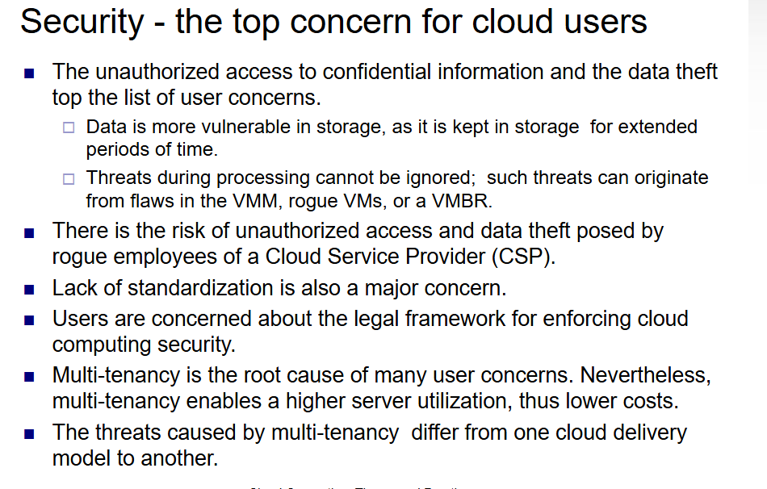

Slide 5
The contract between a user and a CSP should [400] state clearly:
1. CSPs obligations to handle sensitive information and its obligation to comply with privacy laws.
2. CSP liabilities for mishandling sensitive information, e.g., data loss.
3. The rules governing ownership of the data.
4. Specify the geographical regions where information and backups can be stored.

Slide 6
Cloud security threats
A cloud could be used to launch large-scale attacks against other components of the cyber infrastructure.
1. How the nefarious use of cloud resources can be prevented?
2. What are the security risks faced by cloud users?
Solutions:There are multiple ways to look at the cloud security risks.
traditional security threats.
system availability threats.
third-party data control threats.

Slide 7
Traditional threats are those experienced for some time by any system connected to the Internet, but with some cloud-speciﬁc twists. The impact of traditional threats is ampliﬁed due to the vast amount of cloud resources and the large user population that can be affected.
The traditional threats begin at the user site. The user must protect the infrastructure used to connect to the cloud and to interact with the application running on the cloud. This task is more difﬁcult because some components of this infrastructure are outside the ﬁrewall protecting the user.
The traditional threats begin at the user site. The user must protect the infrastructure used to connect to the cloud and to interact with the application running on the cloud. This task is more difﬁcult because some components of this infrastructure e are outside the ﬁrewall protecting the user.
Cloud service provider attacks:
distributed denial of service (DDDS) .
phishing,
SQL injection,
or cross-site scripting

Slide 8
Availability of cloud services is another major concern. System failures, power outages, and other catastrophic events could shutdown cloud services for extended periods of time.
Third-party control generates a spectrum of concerns caused by lack of transparency and limited user control. For example, a cloud provider may subcontract some resources from a third party whose level of trust is questionable.

Slide 9
The 2010 Cloud Security Alliance (CSA) report. The report identiﬁes seven top threats to cloud computing. These threats are: the abusive use of the cloud, APIs that are not fully secure, malicious insiders, shared technology, account hijacking, data loss or leakage, and unknown risk proﬁle.
The 2011 CSA report. The report “Security Guidance for Critical Area of Focus in Cloud Computing V3.0,” provides a comprehensive analysis of the risks and makes recommendations to minimize the risk in cloud computing

Slide 10
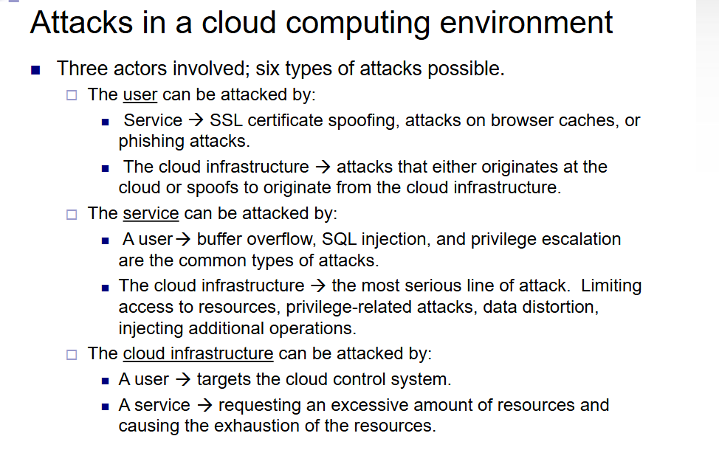

Slide 11
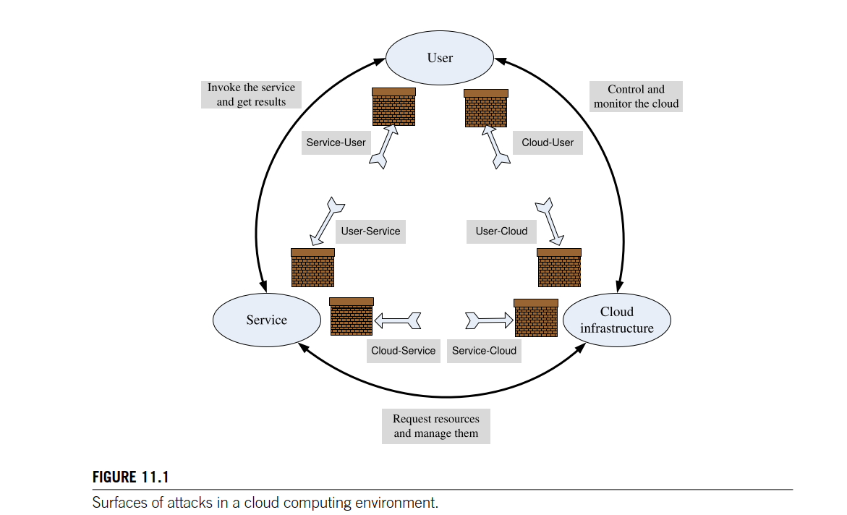

Slide 12
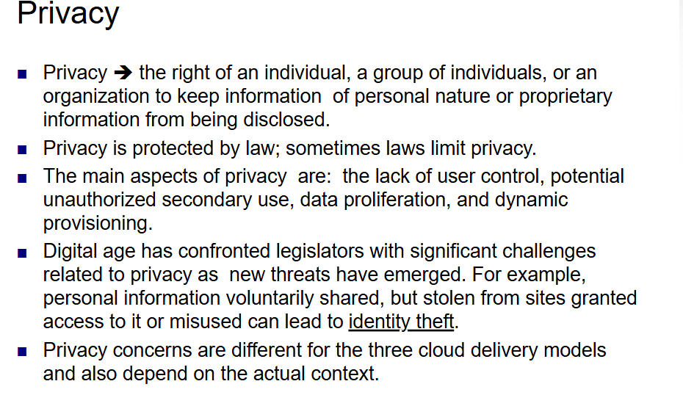

Slide 13
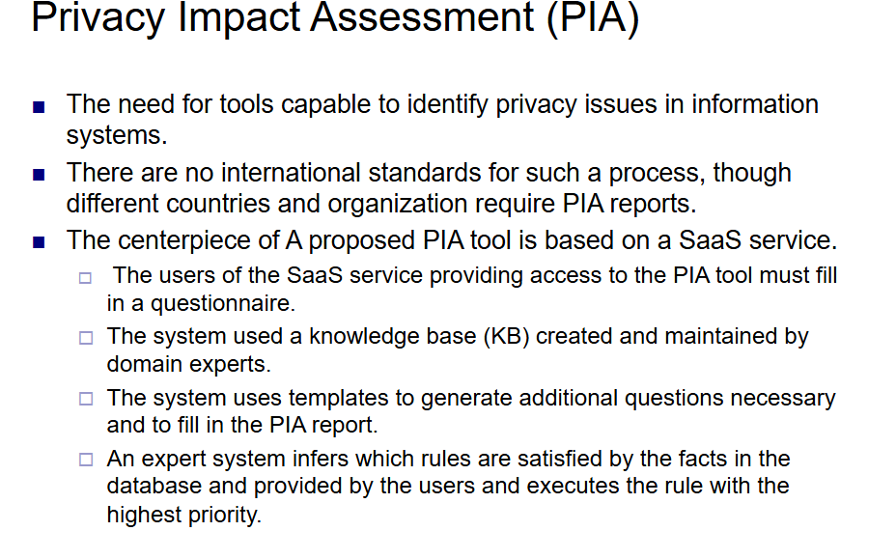

Slide 14
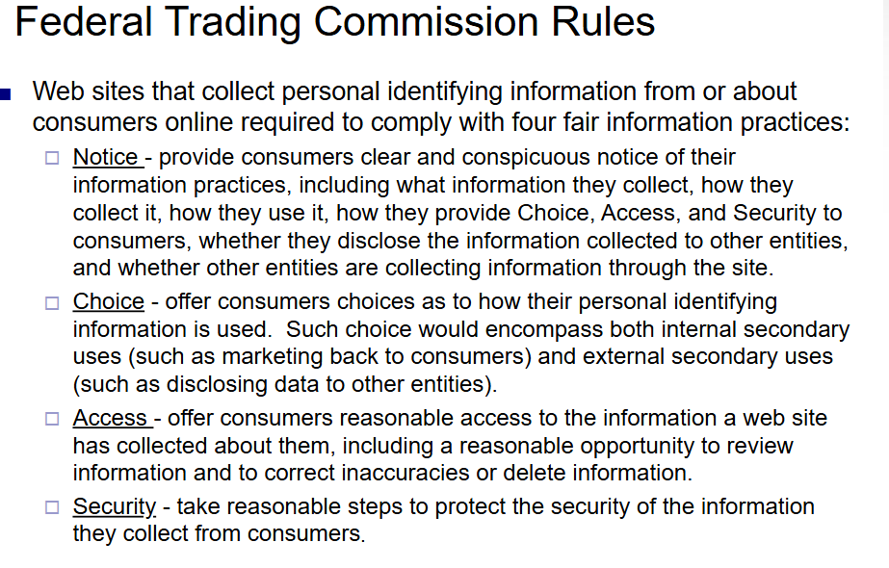

Slide 15
Top twelve cloud security threats according to 2015 reports.
1. Data breaches.
2. Compromised credentials and broken authentication.
3. Hacked interfaces and APIs.
4. Exploited system vulnerabilities.
5. Account hijacking.
6. Malicious insiders.
The other six threats are: advanced persistent threats (APTs), permanent data loss, inadequate diligence, cloud service abuse, DoS attacks, and shared technology.

Slide 16
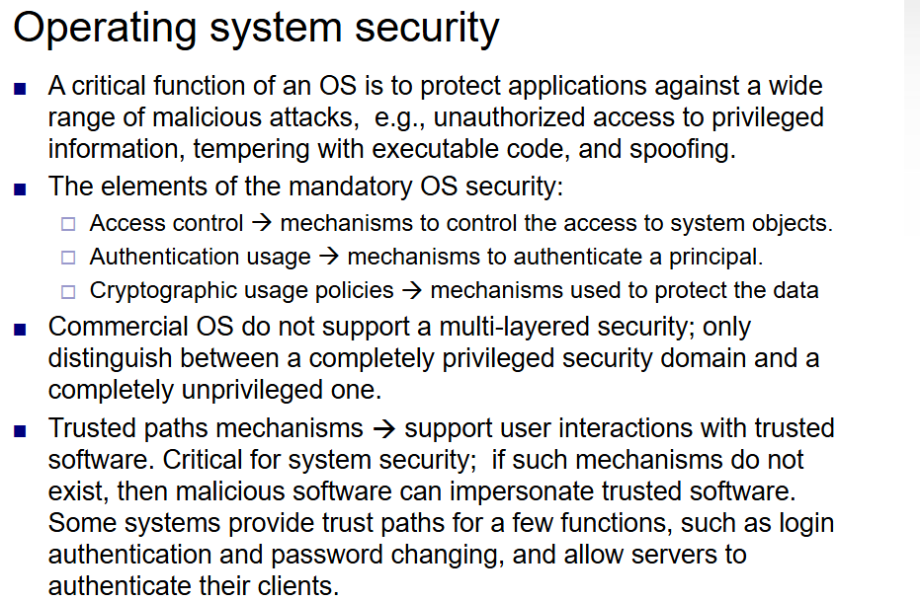

Slide 17
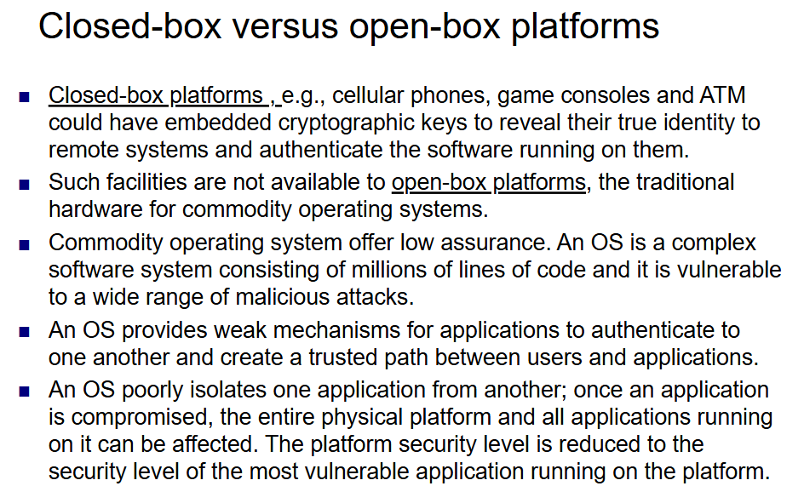

Slide 18
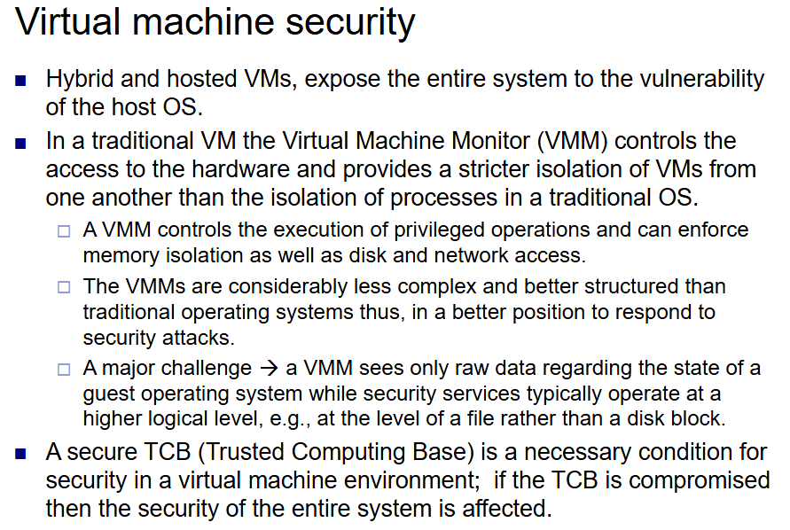

Slide 19
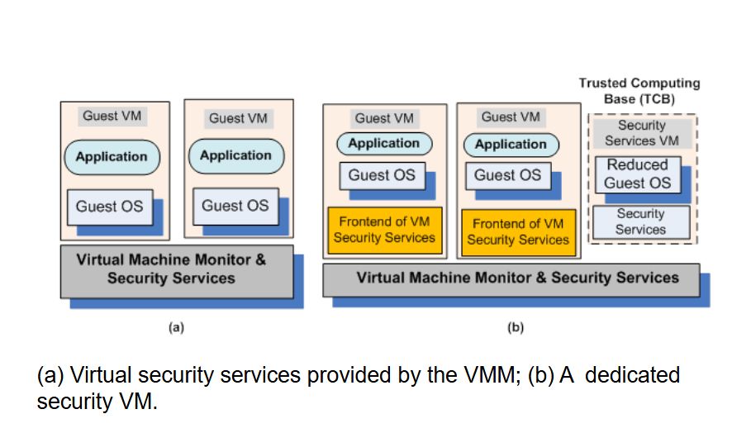

Slide 20
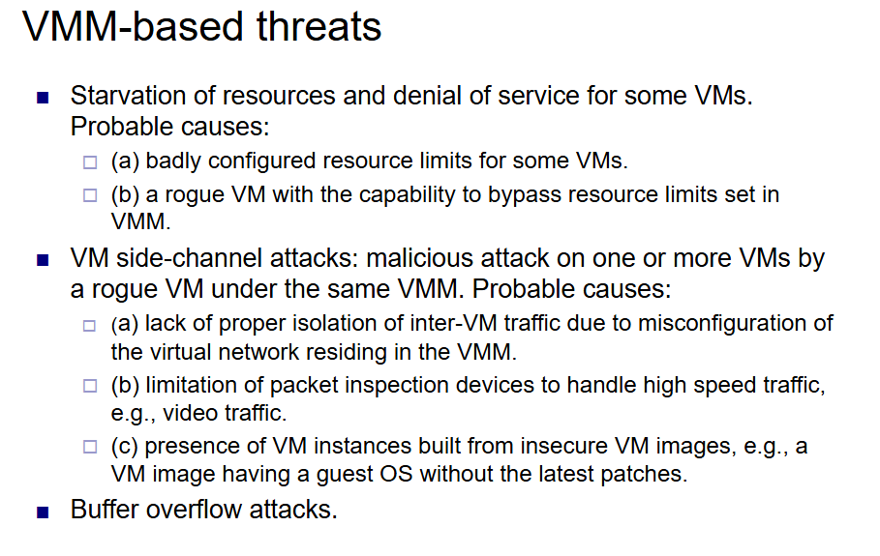

Slide 21
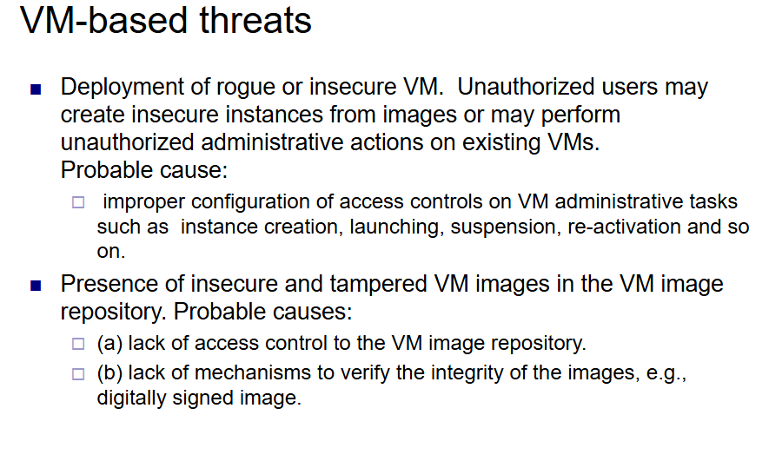

Slide 22
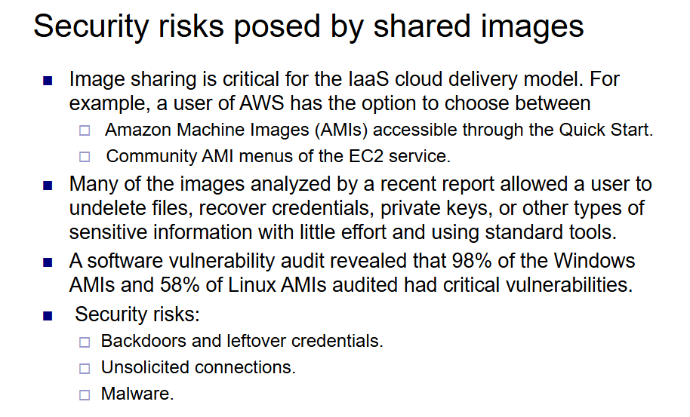

Slide 23
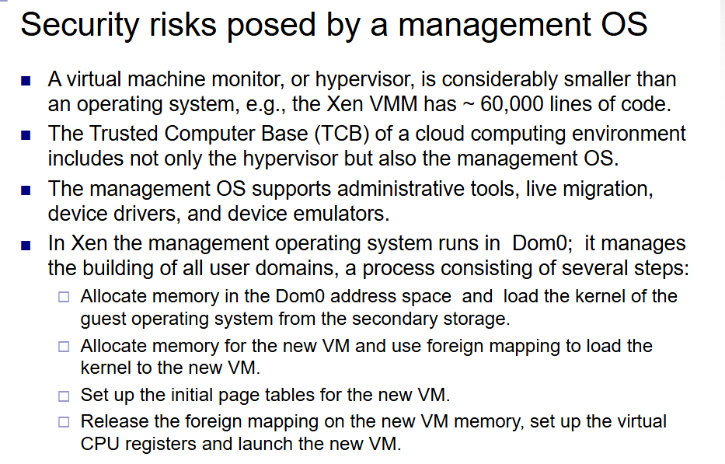

Slide 24
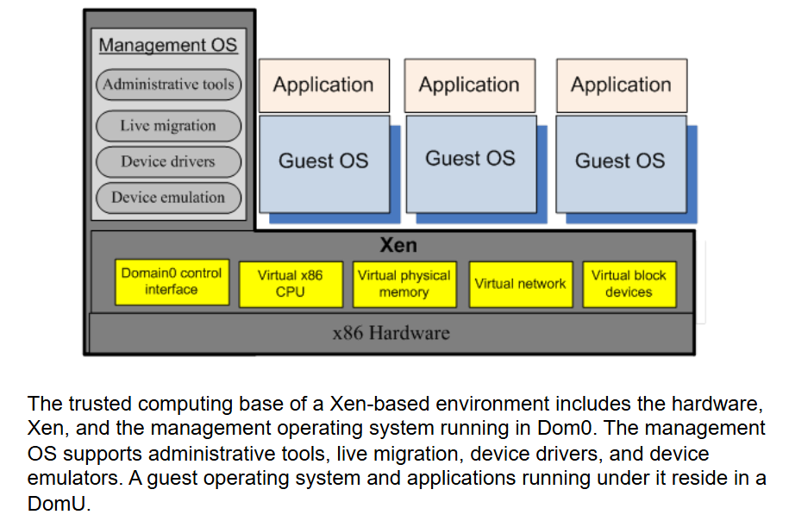

Slide 25
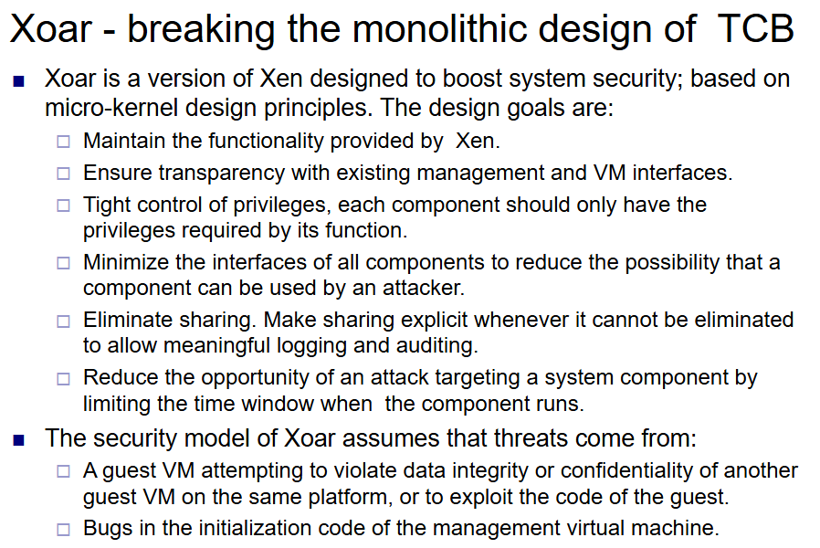

Slide 26
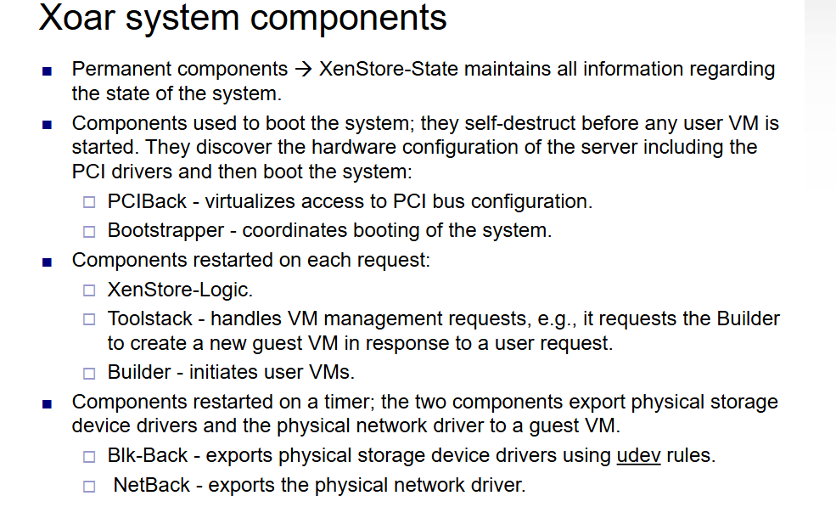

Slide 27
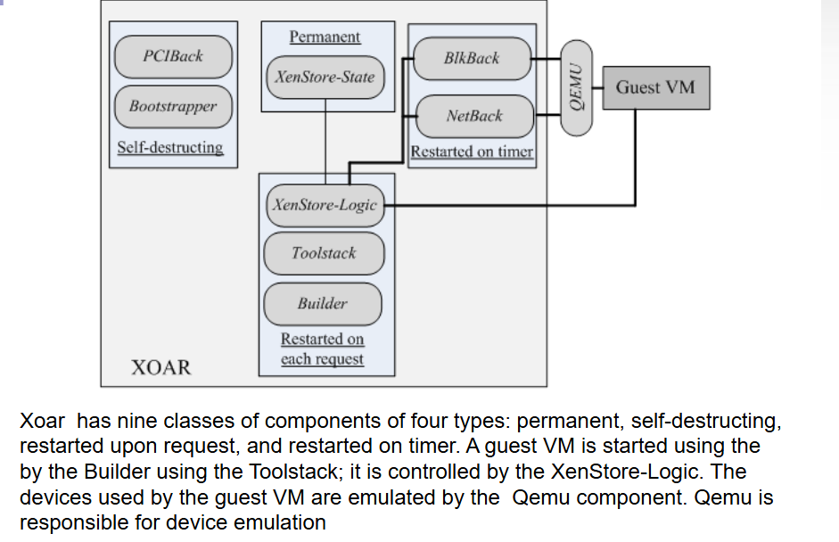

Slide 28
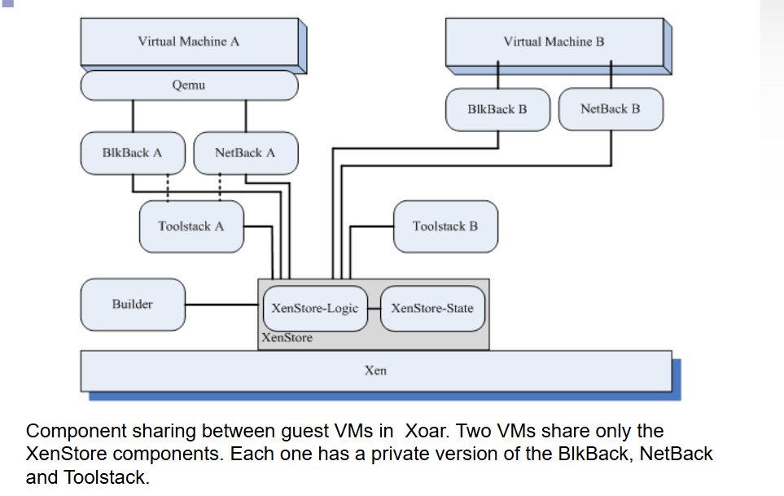

Slide 29
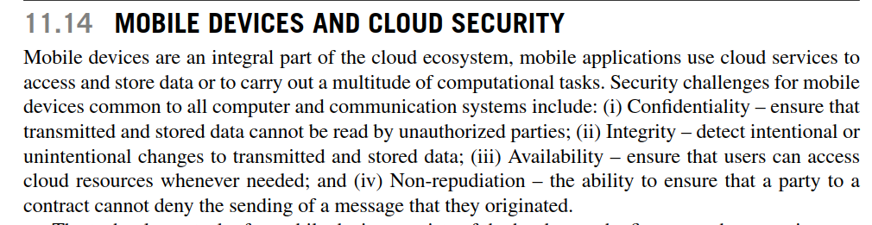
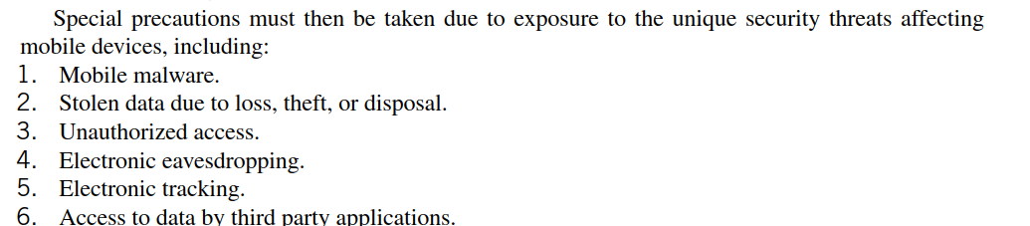

Slide 30
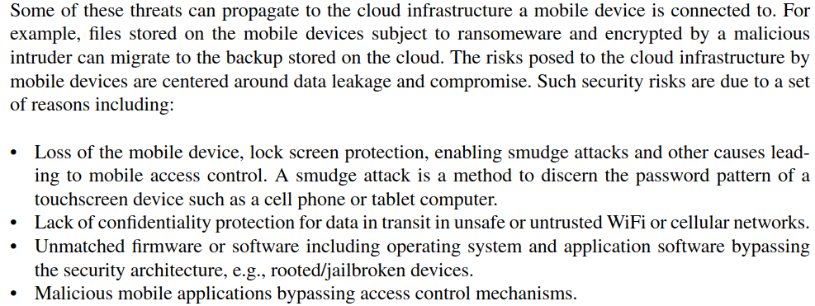

Slide 31
